Slide 1
Lecture 22:
6.1. “Deep Roots”, Path Dependence, and “Institutions”
Brad DeLong
Department of Economics & Blum Center, U.C. Berkeley; & WCEG
last revised: Su 2020-04-12
for presentation: Tu 2020-04-21
Original course by Melissa Dell (Harvard Econ 1342), revised by Brad DeLong
<https://github.com/braddelong/public-files/blob/master/econ-135-lecture-22.pptx>
< https://www.icloud.com/keynote/05N8XZw4qR5Kt2ZyidLMIHtqA>

Slide 2
Discussion
“Deep Roots” and Path Dependence:
What strikes you as important here?

Slide 3
“Deep Roots” & Path Dependence
Econ 135: Tu Apr 21: 5.4. “Deep Roots” & Path Dependence:
Read Before: Nathan Nunn (2012): Culture and the Historical Process <https://delong.typepad.com/files/nunn-culture.pdf>
Slides: <https://github.com/braddelong/public-files/blob/master/econ-135-lecture-22.pptx>
Discussion Thread <>
Lecture Notes <>

Slide 4
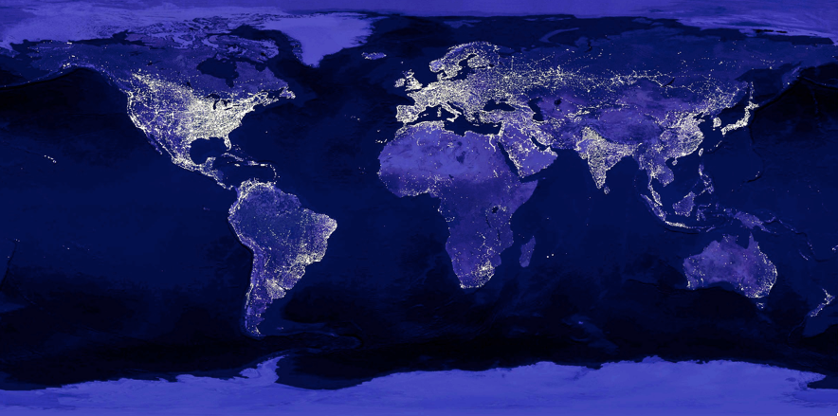
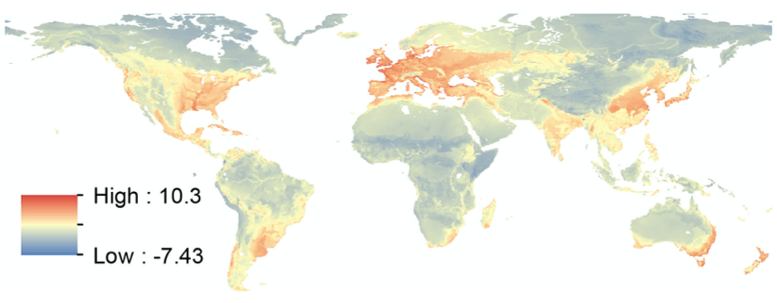

Lights from Space
Top is artificial illumination at night:
This reveals the global geographical distribution of human economic activity
Bottom is what is predicted from a regression of lights on geographical variables:
Base (ruggedness & malaria)
Soil & climate (suitability for agriculture)
Trade (ease of communication and transport by water)
“Geography” accounts for half of the global land variation in lights from space today
It has been a long time—500 years?—since humanity was tied in its location to where the most productive farms were
It has been a shorter but still substantial time—200 years—since humanity was bound in its location by the essential need for cheap water transport
Yet those factors are the “deep roots” of relative economic development, even though there is no geographical necessity today
And humanity’s geographical distribution of economic activity exhibits “path dependence”: the places where people settled and produced for reasons of trade and agriculture 500 and more years ago are still the places where people settle and produce.
8:00 minutes of audio
Vernon Henderson, Tim Squires, Adam Storeygard, and David Weil: The Global Distribution of Economic Activity: Nature, History, & the Role of Trade <https://github.com/braddelong/public-files/blob/master/readings/article-henderson-geography.pdf> <https://github.com/braddelong/public-files/blob/master/readings/article-henderson-geography-ii.pdf>
2:00
Notes:
The top image on rhe right is what our weather satellites would see if there ever were to be a completely cloudless night in terms of artificial illumination: human lights from space. This reveals the global geographical distribution of human economic activity—it is a function of population density, the need for nighttime illumination, and wealth, the power to spend resources producing nighttime illumination.
The bottom is the predicted values of nighttime illumination from a regression of nighttime lights on “geographical” variables: a base set composed of ruggedness and susceptibility to malaria, an “agricultural” set attempting to capture suitability for dense agriculture as a function of soil and climate, and a “trade” set capturing ease of communication and transport by water.
“Geography” measured according to this framework can account for half of the global land variation in nighttime lights visible from outer space today.
It has been a long time—500 years?—since humanity was tied in its location to where the most productive farms were.
It has been a shorter but still substantial time—200 years—since humanity was bound in its location by the essential need for cheap water transport.
Yet those factors are the “deep roots” of relative economic development, even though there is no geographical necessity today. And humanity’s geographical distribution of economic activity thus exhibits “path dependence”: the places where people settled and produced for reasons of trade and agriculture 500 and more years ago are still the places where people find it advantageous to settle and produce, largely because of consequences springing from the happenstance that long ago, back when agricultural suitability and water transport really mattered, people found it advantageous long ago to settle there and produce.

Slide 5
What Does This Get Right? Wrong?
It gets a lot very right:
But it is not a perfect fit
Regions that are surprisingly prosperous?
Johannesburg & surroundings
India
The Persian Gulf
Northwest Europe/eastern USA
Coastal Brazil
Malaya and Java
Reasons that are not as prosperous as expected?
The lower Mississippi basin
The Boomerang Coast & New Zealand
Vernon Henderson, Tim Squires, Adam Storeygard, and David Weil: The Global Distribution of Economic Activity: Nature, History, & the Role of Trade <https://github.com/braddelong/public-files/blob/master/readings/article-henderson-geography.pdf> <https://github.com/braddelong/public-files/blob/master/readings/article-henderson-geography-ii.pdf>
2:45
Notes:
The Pacific coast, the Gulf and Atlantic coasts, the Great Lakes and the Mississippi River of North America; Mexico; the mouth of the Rio de la Plata in South America; Europe; the Boomerang Coast of Australia; New Zealand; North China; Korea and Japan—these are regions where, geographically, we would thus from the geography alone have expected human civilizations to flourish. The narrow focus on geography gets a lot right.
But we would expect it to get a lot right: no conceivable human history would have megacities in the Sahara, the Australian outback, the Siberian tundra, or the swamps of the Amazon basin.
And it gets a substantial amount wrong. There are regions that are surprisingly, surprisingly prosperous today—Johannesburg and its environs in South Africa, nearly all of India, the Persian Gulf, northwest Europe and the northeastern and midwestern United States of America, Malaya and Java, and the coast of Brazil. There are regions that arr not as prosperous as the geography would have lead one to expect: the lower Mississippi basin, plus New Zealand and the Boomering Coast of Australia.
We can tell stories about all of these.
Johannesburg is the result of the extraordinary value of gold in human economies, in the enormous deposits of the Witwatersrand, plus the development in the late 1800s of technologies to exploit them. The Persian Gulf is because oil. The Boomerang Coast and New Zealand are because of geography—in this case, their distance from other human population centers. The lower Mississippi basin is because America was settled from the wrong edge, as a result of (a) the British’s winning their Second Hundred Years War with the French, (b) British settlements starting out in Boston and Philadelphia rather than in the natural New Orleans, and (c) the railroad plus the Erie Canal caming along before New Orleans’s natural geographic advantages could begin to tell.
It is "deep roots", not inevitable destiny: the roots were there, but then the plant had to grow. It is "path dependence”: the flap of the butterfly’s wings leading to self reinforcing processes that took on a life and force of their own nearly or totally independent from what the initial fundamentals had been or whether they were still at all relevant.

Slide 6
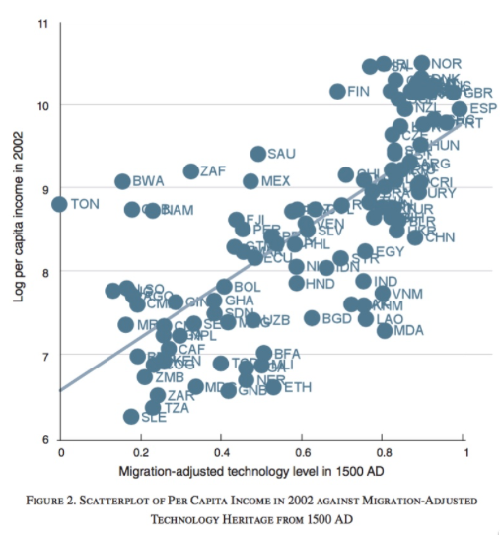
Technological Persistence
Take a look at what relative level of technological development economies were at in 1500:
Half of the relative technological level in 1500 is predicted by the relative technological level in -1000
When people move, they tend to carry their technologies with them
Across economies, half of the variation in log income per capita today is accounted for by the migration-adjusted level of technology back in 1500
Biggest outliers:
Vietnam, Laos, Cambodia, India—and Moldovia
Burkina Faso, Mali, Niger, Ethiopia, Guinea Bissau, Tanzania, Sierra Leone, and Madagascar
Tonga, Botswana, South Africa, Saudi Arabia, and Mexico
Most influential observations:
the global north in the upper right, and much of sub-Saharan tropical Africa in the lower left
Diego Comin, William Easterly, and Erick Gong: Was the Wealth of Nations Determined in 1000 BC? <https://github.com/braddelong/public-files/blob/master/readings/article-comin-wealth-of-nations.pdf>
3:00
Notes:
Alternatively, take a look at the relative levels of technological development economies were in different places back half a millennium ago, in 1500:
Looking backwards from 1500, half of the relative technological level in 1500 is predicted by the relative technological level in the year -1000, back when David and Solomon were kings in Jerusalem, back when the alphabet had been barely invented.
It is a fact that when people move, they tend to carry their technologies with them to a considerable extent. Persistence is thus better measured, perhaps, not in terms of places but in terms of the places in which the ancestors of the people living there now predominantly lived. Across economies, half of the variation in log income per capita today is accounted for by the migration-adjusted level of technology back in 1500.
The relationship is not terribly tight. There are substantial outliers. The biggest outliers among those that had a high technology level in 1500 are: Vietnam, Laos, Cambodia, India—and Moldovia. The biggest outliers that technology in 1500 says should be poor but are surprisingly so are pretty much all in sub-Saharan Africa: Burkina Faso, Mali, Niger, Ethiopia, Guinea Bissau, Tanzania, Sierra Leone, and Madagascar
The biggest outliers that are substantially richer today than the migration-adjusted level of technology where the population’s ancestors lived in 1500 would predict are Botswana, South Africa, Saudi Arabia, Mexico—and Tonga. Dutch and British settlers brought a great deal of technology with them to the southern tip of Africa, even though they are not close to having been ancestors of the majority of the population. The British also brought oil extraction technologies to Saudi Arabia. And the Spanish and the British brought far more technologies to Mexico and Tonga than settler numbers suggest.
And the most influential observations driving the association are what you would expect: the global north in the upper right of the graph, and much of sub-Saharan tropical Africa in the lower left. To those who had, technologically, back in 1500 much more hath been given; to those who had not, technologically, back in 1500, technology aquisition and deployment has been surprisingly hard given how closely tied together the world is in transport and communications, and how easy engineering is to learn and to teach.

Slide 7
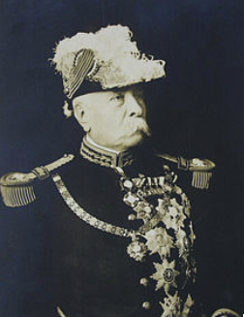
Drought, Revolution, & Development in Mexico
The end of the Porfiriato:
Porfirio Diaz, President of Mexico 1876-1911
Patrimonial régime
No improvement in life expectancy
National income per capita up from $1400 to $2700
Stable at 35% of the U.S. level
Porfiriato benefitted hacendados, foreign investors, his own allies
Labor, campesinos, “liberals”, frozen-out elites thought that Mexico should be doing better
80 years old in 1910
Promised not to run again in 1910
Reneged on his promise, and declared he had won a landslide victory
Widespread revolt broke out
Revolution 1911-1920
Starts as elite deposition of Diaz
Becomes much broader
Melissa Dell (2015): Path Dependence in Development: Evidence from the Mexican Revolution <https://github.com/braddelong/public-files/blob/master/readings/article-dell-mexican-revolution.pdf>
0:45
Notes:
Alternatively, let’s talk about drought, revolution, & development in Mexico.
The year 1911 brought the end of the Porfiriato: the thirty-five year period in which Mexico had been ruled by a single man, President Porfirio Diaz, who had taken power in 1876. Diaz ran a patrimonial régime.
Diaz was 80 in 1910. Diaz promised not to run again in 1910. Diaz reneged on his promise, and declared he had won a landslide victory. And widespread revolt broke out
The Mexican Revolutionw was to run from 1911-1920. It started as an elite deposition of Diaz and the creation of a formally democratic regime. It soon became much broader…

Slide 8
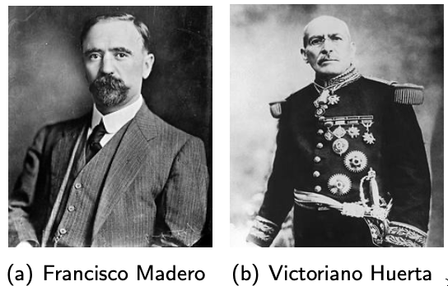
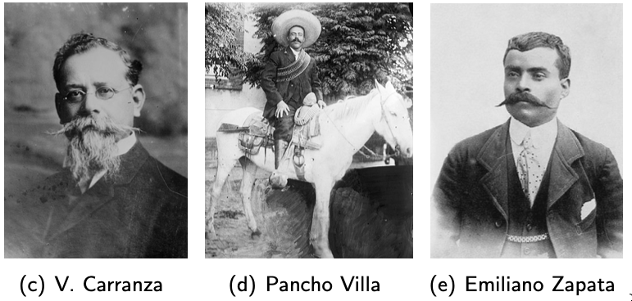
The Mexican Revolution
1911-1920:
Starts as elite deposition of Diaz
Things get confusing:
1910-11: Diaz vs. Maderistas, Orozquistas, Magonistas, Zapatistas
1911-13: Maderistas vs. Bernardo Reyes, Mareo Valesques, Felix Diaz, Orozquistas, Magonistas, Zapatistas
1913-1914: Victoriana Huerta vs. Villistas, Zapatistas, Carrancistas
1914-1919: Villistas, Zapatistas, Félix Díaz, Aureliano Blanquet vs, Carrancistas
1920: Alvaro Obregon, Zapatistas vs. Carrancistas
In the end the Carrancistas won
But the last act of the revolution sees Venustiano Carranza assassinated
By his former general and long-time ally and subordinate Alvaro Obregon
Obregon then became post-revolutionary president 1920-1924
Established the PRI—the Institutional Revolutionary Party, which ruled Mexico as a one party state until the 1990s
Melissa Dell (2015): Path Dependence in Development: Evidence from the Mexican Revolution <https://github.com/braddelong/public-files/blob/master/readings/article-dell-mexican-revolution.pdf>
2:00
Notes:
The Mexican Revolution was to run from 1911-1920. It started as an elite deposition of Diaz and the creation of a formally democratic regime. It soon became much broader. Many, many factions.
1910-11: Diaz vs. Maderistas, Orozquistas, Magonistas, Zapatistas
1911-13: Maderistas vs. Bernardo Reyes, Mareo Valesques, Felix Diaz, Orozquistas, Magonistas, Zapatistas
1913-1914: Victoriana Huerta vs. Villistas, Zapatistas, Carrancistas
1914-1919: Villistas, Zapatistas, Félix Díaz, Aureliano Blanquet vs, Carrancistas
1920: Alvaro Obregon, Zapatistas vs. Carrancistas
In the end the Carrancistas won—although, in the last act of the revolution, Venustiano Carranza was assassinated by his former general and long-time ally and subordinate Alvaro Obregon, who then became post-revolutionary president 1920-1924
Obregon then established the PRI—the Institutional Revolutionary Party, which ruled Mexico as a one party state until the 1990s

Slide 9
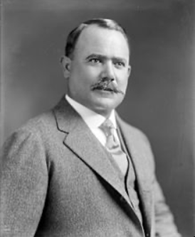
What Was the Mexican Revolution?
In the end the Carrancistas won:
But the last act of the revolution sees Venustiano Carranza himself assassinated
By his former general and long-time ally and subordinate Alvaro Obregon
You can see the Mexican Revolution as a(n at least) three-cornered fight, between:
Those who wanted to control the government and its patronage
Those who wanted a more democratic, more liberal, more open society less prone to caudillismo
Those who wanted land reform and a more egalitarian distribution of property more generally
Obregon then became post-revolutionary president 1920-1924
Established the PRI—the Institutional Revolutionary Party
The PRI ruled Mexico as a one party state until the 1990s
The PRI had elements of all three
Therefore what actually happened as a result of the Mexican Revolution depended on the strength of forces—patrimonial, liberal, power elite, populist—on the ground
Melissa Dell (2015): Path Dependence in Development: Evidence from the Mexican Revolution <https://github.com/braddelong/public-files/blob/master/readings/article-dell-mexican-revolution.pdf>
1:45
Notes:
What was the Mexican Revolution? It was very many things. And it ended messily. In the end the Carrancistas won. But the last act of the revolution sees Venustiano Carranza himself assassinated by his former general and long-time ally and subordinate Alvaro Obregon.
You can see the Mexican Revolution as a(n at least) three-cornered fight, between:
1. Those who wanted to control the government and its patronage
2. Those who wanted a more democratic, more liberal, more open society less prone to caudillismo
3. Those who wanted land reform and a more egalitarian distribution of property more generally
Obregon became post-revolutionary president 1920-1924. He established and cemented the role of the PRI—the Institutional Revolutionary Party. The PRI then ruled Mexico as a one party state until the 1990s
The PRI had elements of all three factions: It contained those who wanted to control government patronage and use it to hold power and to get rich. It contained those who wanted a more democratic, more liberal, less authoritarian, less patrimonial régime. And it contained those who wanted more populism in the sense of land reform, property ownership equalization, and the insulation of individuals and traditional styles of life against the gales of the market.
Therefore what actually happened as a result of the Mexican Revolution depended on the strength of forces—patrimonial, liberal, power elite, populist—on the ground

Slide 10
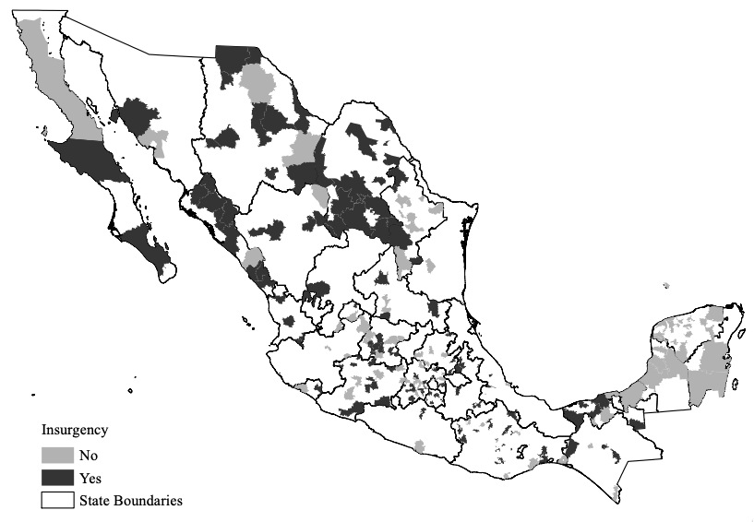
Land Reform—& Thus Institutions—Were Local
Where there were local peasant insurgencies demanding land reform, there was land reform:
There were many local insurgencies
There were also many places in which the rural scene was quiet
And there was no large-scale uprising
Land reform in the wake of insurgency included:
Confiscation of the land from hacendados
Allocation of the land to the campesinos
In an institutional form called the ejido
You could not sell your ejido
By the same token a rich guy could not take it away from you if you defaulted on a debt
Trading away the ability to pledge your land for finance in order to be entrepreneurial for security and a permanent floor keeping you from becoming a landless dependent or beggar
But State and federal officials had influence over the distribution of plots
Melissa Dell (2015): Path Dependence in Development: Evidence from the Mexican Revolution <https://github.com/braddelong/public-files/blob/master/readings/article-dell-mexican-revolution.pdf>
1:15
Notes:
The local granularity of the consequences of the Mexican Revolution meant that land reform—and hence post-revolutionary agrarian institutions—were local events.
Where there were local peasant insurgencies demanding land reform, there was land reform.There were many local insurgencies. There were also many places in which the rural scene was quiet, and there was no large-scale uprising
Where there was land reform in the wake of insurgency as a result of the revolution, it included: (1) the confiscation of the land from hacendados, (2) the allocation of the land to the campesinos (3) in an institutional form called the ejido.
You could not sell your ejido. It was not marketable private property. It was yours and your family’s. And that was that.
You could not sell it if you wanted to stop being a farmer and move to the city—you had to pass it to a relative. But by the same token a rich guy could not take it away from you if you defaulted on a debt
The ejido as an institution thus involved the campesinos’ trading away the ability to pledge your land for finance in order to be entrepreneurial, for security and a permanent floor keeping you from becoming a landless dependent or beggar

Slide 11
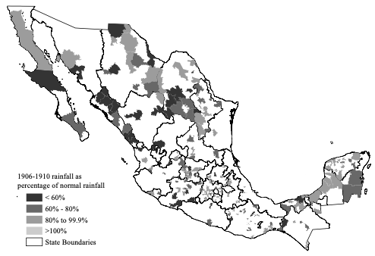
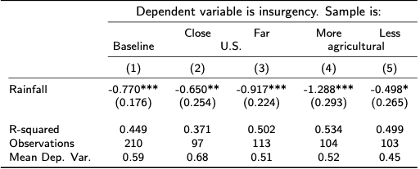
Where Were There Insurgencies?
There were insurgencies where there was drought 1906-1910:
Torreon (Coahuila):
Huge crowds formed and began to ransack large properties and attack Chinese immigrants on the streets...Over 250 Chinese died in the sack of Torreon (Knight, 1986, p. 207)…. Common people swaggering in the streets believed the day had come when all were equal and made respectable ladies walk down the middle of the street (Knight, 1986, p. 209)...
On October 1st, 1914, Torreon fell to Pancho Villa’s forces...
Coatepec (Mexico State):
1915: Constructed the first primary school in this municipality, which consisted of three classrooms.
”In Coatepec Harinas, the revolutionary era did not cause the disruptions that other areas suffered.” (Encyclopedia of Mexican Municipalities)
1:00
Notes:
Where were there insurgencies during the Mexican Revolution? It turns out that there were insurgencies over 1910-1915 in places in which there had been droughts over 1906-1910. Melissa Dell counterposes two localities: Torreon in Coahuila and Coatepec in Mexico state. In Coatepec, the years of the Mexican revolution and civil war saw, instead of violence, the construction of the first primary school in the municipality, which avoided “the disruptions that other areas suffered”. In Torreon, drought and poverty led to the breakdown of civil order:
>Huge crowds formed and began to ransack large properties and attack Chinese immigrants on the streets…. Over 250 Chinese died in the sack of Torreon…
Plus:
>Common people swaggering in the streets believed the day had come when all were equal and made respectable ladies walk down the middle of the street…
So drought produced local revolutionary insurgency. And local revolutionary insurgency produced ejidos.

Slide 12
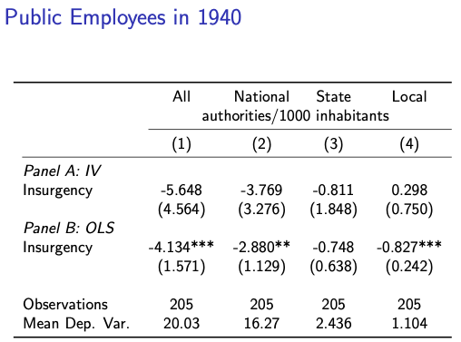
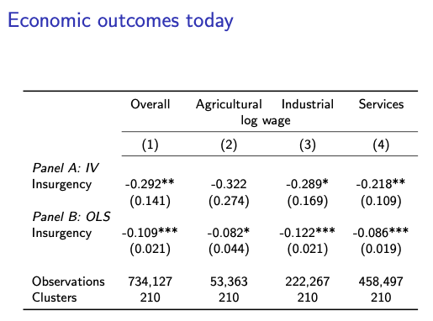
Where Were the Effects of Having Ejidos?
Ejidos today:
Account for 54% of Mexico’s land area
Account for two thirds of Mexico's arable land area
Account for over half of its rural population.
Ejidos reduced access to functioning credit markets (DeWalt, 1979; Wilkie, 1971).
Ejidos promoted clientelistic politics (Benjamin, 1989; de Janvry et. al, 1997; Ronfeldt, 1973; Larreguay, 2013)
Ejidal lands were a key instrument for generating PRI political support
Insurgent municipalities received more land reform and today are poorer, more agricultural, less industrial, and less politically competitive
Agrarian reform may be important for promoting stability, but can impose significant long-run costs when it is accompanied by major restrictions on markets or the politicization of agriculture
1:30
Notes:
What did ejidos produce?
Ejidos today:
* Account for 54% of Mexico’s land area
* Account for two thirds of Mexico's arable land area
* Account for over half of its rural population.
Ejidos reduced access to functioning credit markets (DeWalt, 1979; Wilkie, 1971): that meant that if you wanted to be entreprenurial and enterprising, you needed to move to Mexico City—for since you could not pledge your ejido land, you could not start a business in the countryside.
Ejidos promoted clientelistic politics (Benjamin, 1989; de Janvry et. al, 1997; Ronfeldt, 1973; Larreguay, 2013). Ejidal lands were a key instrument for generating PRI political support. The moneylender could not throw you off your ejido. But quite possibly the local official could—and the local official was a member of the PRI
Insurgent municipalities received more land reform and today are poorer, more agricultural, less industrial, and less politically competitive.
Was the ejido a good or a bad thing? Many fewer peasants were thrown off of what had been their land by moneylenders after their business went crash or after they imprudently borrowed to tide themselves over a bad crop year. I think we can be confident that income distribution was more equal. But wealth was noticeably less. Agrarian reform may be important for promoting stability, but can impose significant long-run costs when it is accompanied by major restrictions on markets or the politicization of agriculture.

Slide 13
“Deep Roots” and Path Dependence in Mexico
A good deal of rural prosperity or its absence today hinges on roots from 1905-10:
The flap of the butterfly’s wings
And then path dependence
Drought ⇒ insurgency
Insurgency ⇒ land reform & ejidos
Ejidos ⇒ manifold consequences, including slower growth
A modest event—here the 1907-1910 drought—exerts large and persistent effects
0:45
Notes:
Melissa Dell’s story of drought, revolution, insurgency, ejido, and then restrictions on market led development is a very interesting example of deep roots and path dependence. A good deal of rural prosperity or its absence in Mexico today today hinges on roots from 1905-10: The flap of the butterfly’s wings, and then path dependence. A modest event—here the 1906-1910 drought—exerts large and persistent effects.
If we add up enough of these can we explain why in so much of the world today it seems as though history is destiny as far as development is concerned? We quite possibly can.

Slide 14

Culture and the Historical Process
A great dissatisfaction with what are called “institutions” here:
Nathan Nunn (2012): Culture and the Historical Process <https://delong.typepad.com/files/nunn-culture.pdf>
Culture as heuristics—the way you jump when choosing strategies in (possibly cooperatives) interpersonal games
Long-run historical shadows cast by history that produce “cultural” differences:
The plough and gender roles
The African slave trade(s) and “trust”
Italian cities’ levels of social capital (Guiso, Sapienza, and Zingales)
Mediterranean mercantile cultures (Avner Greif)
The “Protestant ethic”?
3:45
Notes:
The thing that is unsatisfactory about this approach is its assessment of what the deep roots are.
Some of these are unproblematic. Few would have a great deal of disagreement over geography understood as suitability for agriculture. And few would have a great deal of disagreement over geography understood as access to water-born trade. But then things get sticky.
On top of geography we have “institutions”—and perhaps geography plays a role in generating institutions: Alesina & al. (2011) report that societies that have traditionally used plough agriculture have female labor force participation rates fifteen percentage points lower, and plough agriculture is overwhelmingly dependent on climate suitability.
Alberto F. Alesina & al. (2011): On the Origins of Gender Roles: Women & the Plough <<https://github.com/braddelong/public-files/blob/master/readings/article-alesina-gender-plough.pdf>>
We have Douglass North, with his focus on limited, responsible governments that protect private property rights. In his interpretation, it was the Glorious Revolution of 1688 in England that did it, and countries today have good institutions to the extent that they partake of the pattern set up there and then.
We have Daron Acemoglu, Simon Johnson, and James Robinson’s division of the world between places that have “developmental” and places that have “extractive” institutions.
We have those who argue that good institutions require much more than protection of private property and enforcement of contracts. The government needs to build infrastructure, physical and human. In Robert Allen’s formulation, successful development requires property protection and contract enforcement but also ports, railroads, urban infrastructure, banks, schools, plus a tariff to nurture communities of engineering practice in things that can only be learned by doing.
But in what sense are these “institutions” deep roots? In what sense are these any deeper than simply statements that the country’s or the economy’s political economy works? If these are part of “deep roots”, there must then be a path by which history constrains the extent to which a country or economy can build such successful institutions.
Nathan Nunn is a strong believer that institutions are constrained by “culture”, which are the true next layer of deep roots on top of geography. Nunn sees culture’s relevance to institutions and development as “heuristics—the way you jump when choosing strategies in (possibly cooperative) interpersonal games”.
He sees the world as one in which it is not “institutions” but rather cultures that matter. Institutions reflect underlying cultural differences. And if the institutions go against the grain of the culture, they will not matter—or they will dissolve.
In Nunn’s vision, historical accidents matter. History then casts long-run shadows that determine “cultural differences” which then govern economic growth. For example, there is the “plough and gender roles” case noted above. There is the African slave trade and the erosion of trust in Africa—with dire economic consequences. There is the Guiso, Sapienza, and Zingales argument that the destruction of Italian cities’ habits of self-government in the south under the Sicilian regno has left southern Italy with much less “social capital” than northern Italy today. And there is the old Max Weber argument about how the Protestant ethic was essential to awaken the spirit of capitalism.

Slide 15
Legal Origins
La Porta, Lopez-do-Silanes, Shleifer, & Vishny:
Rafael La Porta, Florencio Lopez-de-Silanes, & Andrei Shleifer: The Economic Consequences of Legal Origins <https://github.com/braddelong/public-files/blob/master/readings/article-la-porta-legal-origins.pdf>
France, Germany, Scandinavia, Britain
Britain produces by far the “best” legal system
France poisonous in terms of how convoluted and restrictive their legal systems are
What is not expressly authorized is forbidden…
“Legal Origin Theory traces the different strategies of common and civil law to different ideas about law and its purpose that England and France developed centuries ago. These broad ideas and strategies were incorporated into specific legal rules, but also into the organization of the legal system, as well as the human capital and beliefs of its participants.
“When common and civil law were transplanted into much of the world through conquest and colonization, the rules, but also human capital and legal ideologies, were transplanted as well. Despite much local legal evolution, the fundamental strategies and assumptions of each legal system survived and have continued to exert substantial influence on economic outcomes…
Legal origins not “culture” or “politics”
1:30
Notes:
And then there is the La Porta, Lopez-de-Silanes, Shleifer, & Vishny argument that the “institutions” argument is tautological, and you need to look a level deeper: rather than simply classifying institutions as “predatory” or “developmental”, you need a much more fine-grained appraoch, and to recognize that circumstances matter: French institutions are fine for France, for example, but not elsewhere.
They look explicitly at how the origins of a colonized country’s law code—which colonizer imposed their legal system on it—has large and persistent effects on the functioning of legal systems at a fine-grained level. To quote them on their “legal origins” theory:
>Legal Origin Theory traces the different strategies of common and civil law to different ideas about law and its purpose that England and France developed centuries ago. These broad ideas and strategies were incorporated into specific legal rules, but also into the organization of the legal system, as well as the human capital and beliefs of its participants.
>When common and civil law were transplanted into much of the world through conquest and colonization, the rules, but also human capital and legal ideologies, were transplanted as well. Despite much local legal evolution, the fundamental strategies and assumptions of each legal system survived and have continued to exert substantial influence on economic outcomes…
Note that legal origins are neither cultural nor political, but, rather, institutional—but in a very specific sense.

Slide 16

A Skeptic’s Guide
Dietz Vollrath:
Dietrich Vollrath (2014): A Skeptic’s Guide to Institutions 4 <https://growthecon.com/blog/the-skeptics-guide-to-institutions-part-4/>
Cross-country studies of institutions are inherently flawed by lack of identification and ordinal institutional indexes treated as cardinal
Instrumental variable approaches—settler mortality included—are flawed due to bad data and questions and more identification problems.
Historical studies show that there is path dependence or a poverty trap, but not that institutions themselves are central to underdevelopment
I'm uncomfortable making broad pronouncements that we have to get institutions "right" or "improve institutions" to generate economic development.
Institutions are not a thing that we can easily or independently alter. If they were, then they wouldn't be institutions
Bad institutions get you stuck in a bad equilibrium
The result of a skewed distribution of economic power that grants some elite a skewed amount of political power
The implication is that redistributing wealth away from a predatory elite will lead to economic development
1:45
Notes:
Last, I want to cover Dietz Vollrath’s skeptical take on institutions: institutions theory does not tell us what to do to achieve development today. Institutions thory does not tell us why Africa stagnated from 1960-2000, and then picked up its mat and walked.
There is, Vollrath maintains, strong evidence for poverty traps and path dependence. If something bad happens—quite likely institutionally—in the past that made you poor, you are likely to still be poor. But that is a very different thing than saying that bad institutions today inherited from the past are central to underdevelopment. And there is little reason to think that we have to get institutions "right" or "improve institutions" to generate economic development. We should search for other roads—as China did—to substitute for bad institutions, and so enable growth.
Moreover, even if everything institutions theorists believed was true, that would not help us. We cannot easily or independently change institutions. They are institutions, after all.
Bad institutions get you stuck in a bad equilibrium. They are the result of a skewed distribution of economic power that grants some elite a skewed amount of political power. The implication is that redistributing wealth away from a predatory elite will lead to economic development. But the key is not the institutions—it is the predatory elite, and its power and wealth.

Slide 17
Big Ideas: Lecture 22: “Deep Roots” and Path Dependence
Takeaways from this class:

Slide 18
Readings: Lecture 22: “Deep Roots” and Path Dependence
Required:
Nathan Nunn (2012): Culture and the Historical Process <https://delong.typepad.com/files/nunn-culture.pdf>
Optional:
Diego Comin, William Easterly, and Erick Gong: Was the Wealth of Nations Determined in 1000 BC? <https://github.com/braddelong/public-files/blob/master/readings/article-comin-wealth-of-nations.pdf>
Melissa Dell (2015): Path Dependence in Development: Evidence from the Mexican Revolution <https://github.com/braddelong/public-files/blob/master/readings/article-dell-mexican-revolution.pdf>
Vernon Henderson, Tim Squires, Adam Storeygard, and David Weil: The Global Distribution of Economic Activity: Nature, History, & the Role of Trade <https://github.com/braddelong/public-files/blob/master/readings/article-henderson-geography.pdf> <https://github.com/braddelong/public-files/blob/master/readings/article-henderson-geography-ii.pdf>

Slide 19
Roadmap for the Next Two Weeks…
23. Th Apr 23: 6.2. Growth and Fluctuations; Trade and Development, Foreign Aid
Read Before: Barry Eichengreen (2015): Hall of Mirrors: The Great Depression, The Great Recession, and the Uses-and Misuses-of History, selections <https://delong.typepad.com/files/eichengreen-mirrors.pdf>
Read Before: David Atkin (2014): Endogenous Skill Acquisition and Export Manufacturing in Mexico <https://delong.typepad.com/files/atkin-skill.pdf>
Slides: <https://github.com/braddelong/public-files/blob/master/econ-135-lecture-23.pptx>
24. Tu Apr 28: 6.3. Populism, Plutocracy, Kleptocracy, & Neo-Fascism
Read Before: Ernest Gellner (1973): Nations & Nationalism, selections <https://delong.typepad.com/files/gellner-nations.pdf>
Read Before: Barry Eichengreen (2018): The Populist Temptation Economic Grievance & Political Reaction in the Modern Era, selections <https://delong.typepad.com/files/eichengeeen-populist.pdf >
25. Th Apr 30: 6.4. Global Warming
Read Before: Melissa Dell et al. (2012): Temperature Shocks & Economic Growth: Evidence from the Last Half Century <https://scholar.harvard.edu/files/dell/files/aej_temperature.pdf>
Read Before: Melissa Dell et al. (2014). What Do We Learn from the Weather? The New Climate-Economy Literature, selections <https://economics.mit.edu/files/9138>
26. Tu May 5: 6.5. The Pace and Meaning of Economic Growth
Read Before: William Nordhaus: Do Real-Output and Real-Wage Measures Capture Reality? <https://www.nber.org/chapters/c6064.pdf>
Read Before: John Maynard Keynes: Economic Possibilities for Our Grandchildren<<https://delong.typepad.com/files/keynes-persuasion.pdf>
Read Before: Edward Bellamy (1887): Looking Backward 2000-1887, selections <https://delong.typepad.com/files/bellamy-backward.pdf>

Slide 20
Roadmap Following…
7. Conclusion
Th May 7: 7. Conclusion: The Future?
Read After: Robert Allen (2011): Global Economic History: A Very Short Introduction, selections <https://delong.typepad.com/files/allen-geh.pdf >
W May 13 11:30-14:30: FINAL PAPER/PROJECT DUE

Slide 21
Catch Our Breath…
Ask a couple of questions?
Make a couple of comments?
Any more readings to recommend?

Slide 22

Coronavirus!

Slide 23
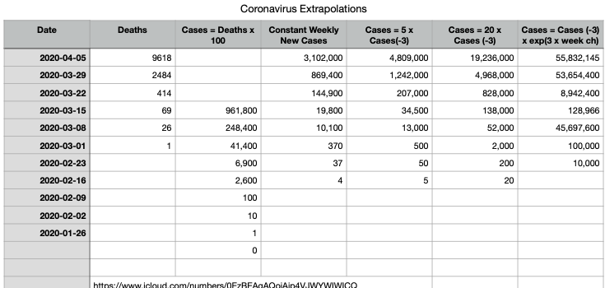
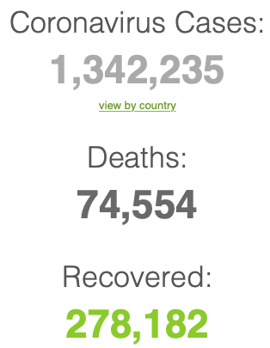
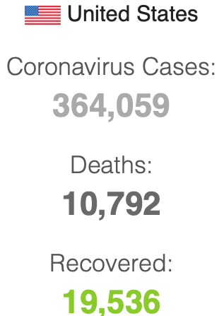

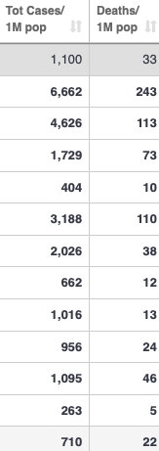
Coronavirus
Where we think we are, as of Th Apr 09:
We really do not know
No random samples…
If we extrapolate out the past week straight-line log:
We will have 440,000 deaths in three weeks
But it is unlikely to be that bad
Best thing I have read comes from Jim Stock <https://drive.google.com/file/d/12MV466ZZy5xHir4xdPhoTrL1oO8CbZU-/view>:
The basic SIR epidemiological model of contagion
The effect of social distancing and business shutdowns on epidemic dynamics enters the model through a single parameter: the case transmission rate β
Re-express the model in terms of β and the asymptomatic (or not very symptomatic) hence non-tested rate—the fraction of the infected who are not tested
The COVID-19 non-testing rate is unidentified in our model
Estimates in the epidemiological literature range from 0.18 to 0.86.
The asymptomatic rate could be estimated accurately and quickly by testing a random sample
The optimal policy response and its economic consequences hinge critically on the asymptomatic rate

Slide 24
Coronavirus II
We do not really know where we are, as of Mo Apr 6:
Best thing I have read comes from Jim Stock <https://drive.google.com/file/d/12MV466ZZy5xHir4xdPhoTrL1oO8CbZU-/view>:
The basic SIR epidemiological model of contagion
The effect of social distancing and business shutdowns on epidemic dynamics enters the model through a single parameter: the case transmission rate β
Re-express the model in terms of β and the asymptomatic (or not very symptomatic) hence non-tested rate—the fraction of the infected who are not tested
The COVID-19 non-testing rate is unidentified in our model
Estimates in the epidemiological literature range from 0.18 to 0.86.
The asymptomatic rate could be estimated accurately and quickly by testing a random sample
The optimal policy response and its economic consequences hinge critically on the asymptomatic rate

Slide 28
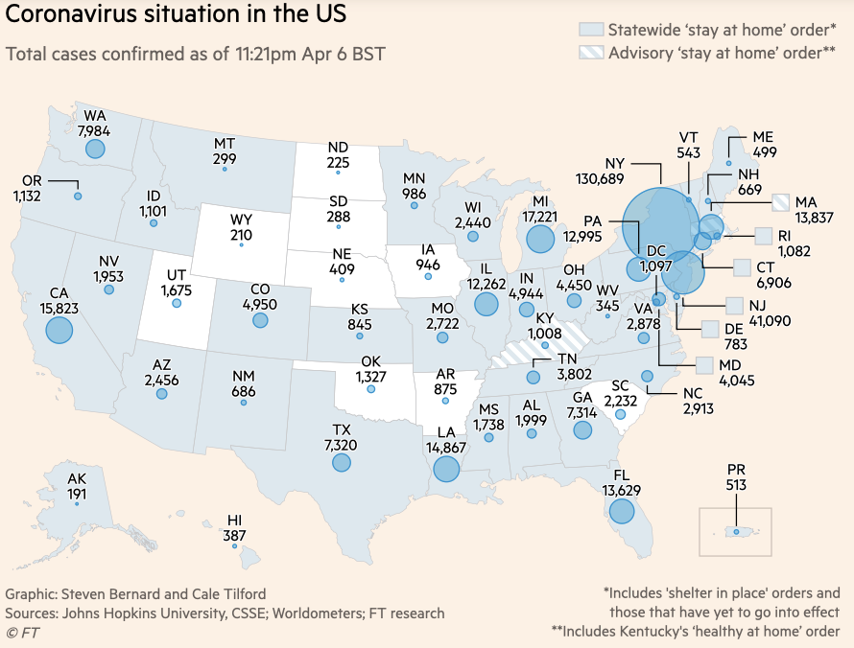
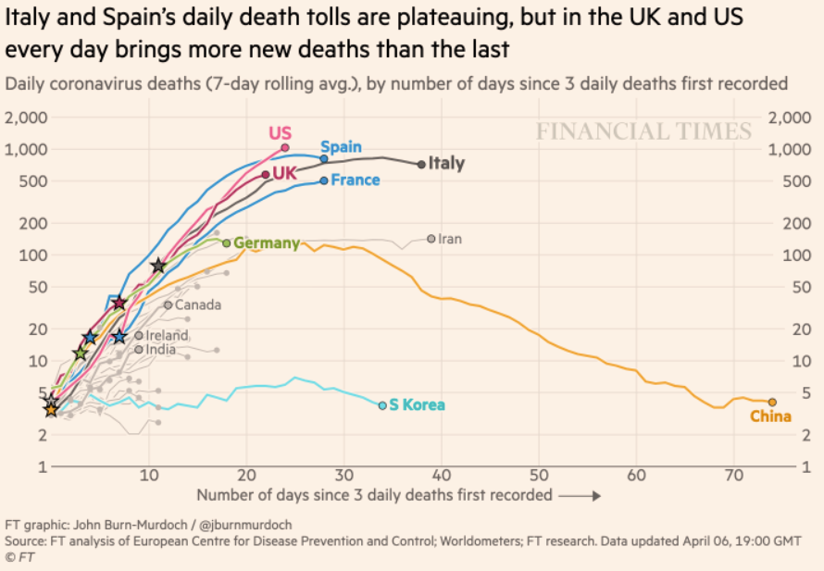
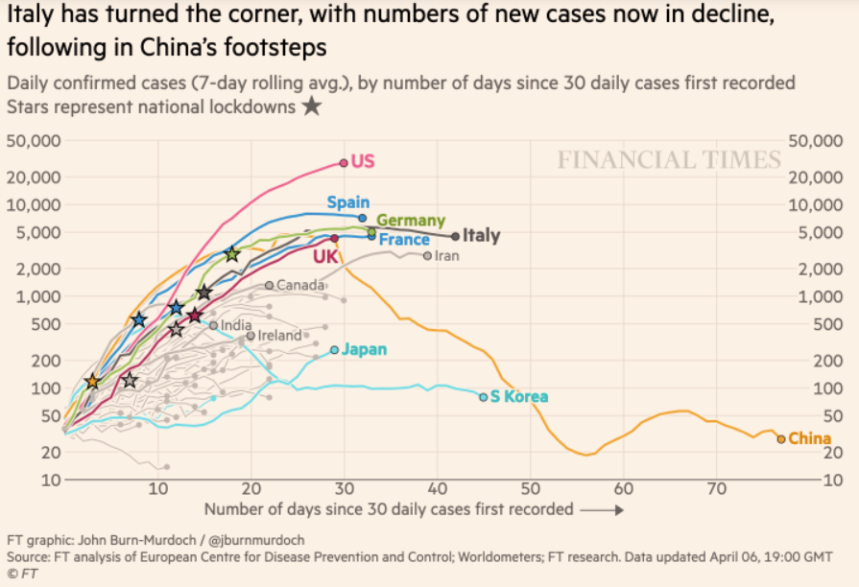
Financial Times Graphs Blown Up…

Slide 32
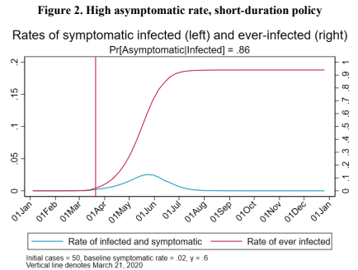
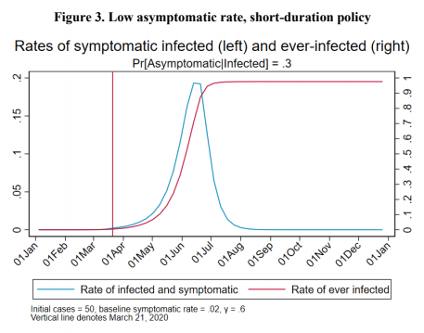
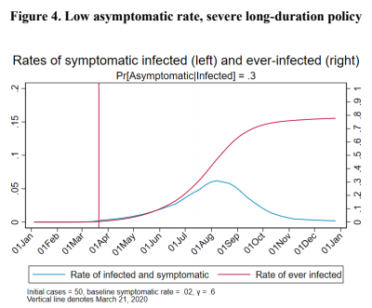
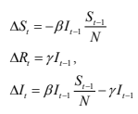
James Stock (2020)
Standard SIR model:<https://drive.google.com/file/d/12MV466ZZy5xHir4xdPhoTrL1oO8CbZU-/view>:
Susceptible, Infected, Recovered (& immune), transmission rate β, recovery rate γ, reproduction number R0, asymptomatic hence non-tested rate π0
Calibration: half-life of infection one week: γ = 0.5, s0 = 0.02, 50 cases on Jan 24
For March 21, 2020, the positive test rate in the United States is approximately 10%…
<https://drive.google.com/file/d/12MV466ZZy5xHir4xdPhoTrL1oO8CbZU-/view>

Slide 37
Bringing the Economy Back Up from Anæsthesia
Major issues:
Certificates of immunity:
Which requires test, test, test:
And not just disease virus tests
Presence-of-antibodies tests
How quickly can we match the immune with public-contact jobs?
What jobs can be done with minimal infection risk?
What minimal-infection substitutes can we find for previous jobs?
How quickly can restrictions be relaxed without the virus coming roaring back?
How do we avoid having the market give a “shutdown” signal to enterprises we in fact want restarted?
Which is pretty much all of them
How much of the potential caseload do we want to push out beyond the vaccine-arrival date?
ALL THESE QUESTIONS ARE ANSWERABLE IF WE LEARN THE ASYMPTOMATIC HENCE NON-TESTED RATE!!

Slide 38
Keeping the Economy from Crashing During the Lockdown
Nick Rowe: We have a 50% output cut in 100% of the sectors:
A temporary 100% output cut in 50% of the sectors (what the Coronavirus does) is very different from a 50% output cut in 100% of the sectors
Nick’s thought experiment:
In three months we are going to invent unobtanium:
Substantial intertemporal substitutibility
Plus lower cross-good contemporaneous substitutitbility
Hence high desired savings rate now
Flex-price market thus produces a nominal rate at the zero lower bound and a high inflation rate over the next three to six months
Plus liquidity-constrained workers in affected sectors see their demand go to zero immediately
Can we get there? Should we get there? What should we do instead?
We need a good RBC economist: are there any?…
<https://worthwhile.typepad.com/worthwhile_canadian_initi/2020/03/relative-supply-shocks-unobtainium-walras-law-and-the-coronavirus.html>

Slide 39
Keeping the Economy from Crashing During the Lockdown II
Nick Rowe:
<https://worthwhile.typepad.com/worthwhile_canadian_initi/2020/03/relative-supply-shocks-unobtainium-walras-law-and-the-coronavirus.html>
Plus: to extend the thought experiment:
We just lost the ability to make “unobtainium”
So we should be substituting leisure for work, and moving workers into relatively unproductive labor, making the commodities we can still produce right now
How should relative prices move as a result? How should we make them move?
Plus: distributional issues
Plus: bankruptcy and credit chain issues

Slide 40
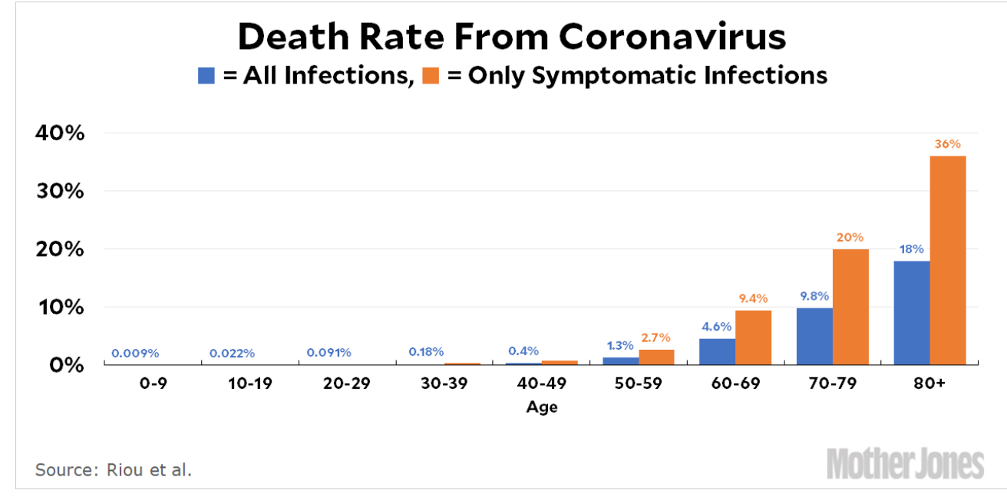
MOAR Coronavirus!
Death for Geezers!
Mortality for the Youngs very low…
It’s the flu for them—for you…
And an extra doubling—or is it 5%?—mortality for the asthmatic
And an extra doubling—or is it 5%?—mortality for the overweight

Slide 41
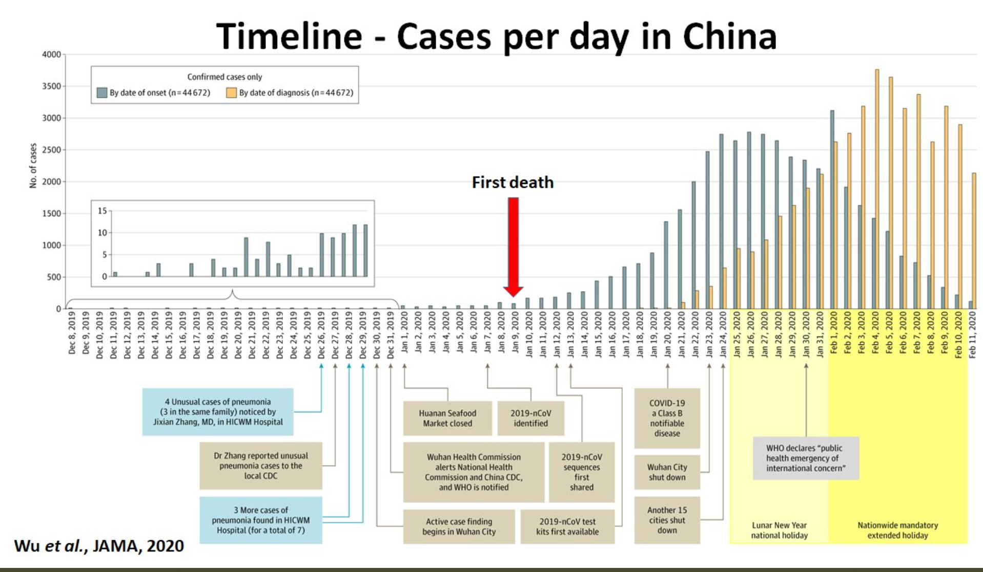
What We Think Happened in Wuhan
China beat it quickly & relatively easily!
We think
Shut down Wuhan when 200 cases per day
That seems to have been a good decision

Slide 42

The Goal
When Is It Appropriate to Move on This?
Immediate social distancing…
Self-isolate if you have a cough and a fever…
Hope that warmer temperatures will do to this what they did to SARS…
Otherwise, when do you want to start spreading out transmission. It seems that early is as good as later, so do it early…
I have no good intuition on why you want to move early
Plus your moving early will be wasted if you get reinfected
Plus the sparks you throw off making others’ lives more difficult

Slide 43
References
Financial Times (2020): Coronavirus Tracked: The Latest Figures as the Pandemic Spreads <https://www.ft.com/coronavirus-latest>
Nick Rowe (2020): Relative Supply Shocks, Unobtainium, Walras' Law, and the Coronavirus <https://worthwhile.typepad.com/worthwhile_canadian_initi/2020/03/relative-supply-shocks-unobtainium-walras-law-and-the-coronavirus.html>
Jim Stock (2020): Coronavirus Data Gaps and the Policy Response <https://drive.google.com/file/d/12MV466ZZy5xHir4xdPhoTrL1oO8CbZU-/view>

Slide 44
MOAR Coronavirus!
What I am watching:
Max Roser & Hannah Ritchie: Coronavirus Disease (COVID-19) <https://ourworldindata.org/coronavirus>…
Worldometer: Coronavirus Update (Live) <https://www.worldometers.info/coronavirus/>: ‘125,599 Cases and 4,605 Deaths from COVID-19 Virus Outbreak…
FT Coronavirus Tracker <https://www.ft.com/content/a26fbf7e-48f8-11ea-aeb3-955839e06441>
Josh Marshall’s COVID Twitter List <https://twitter.com/i/lists/1233998285779632128>
NEJM Group: Updates on the Covid-19 Pandemic <http://m.n.nejm.org/nl/jsp/m.jsp?c=%40kxNtXckRDOq8oG0jJvAXsIzN4mPECIPhltxoTSdTU9k%3D&cid=DM89089_NEJM_COVID-19_Newsletter&bid=173498255>: 'From the New England Journal of Medicine, NEJM Journal Watch, NEJM Catalyst, and other trusted sources...

Slide 45
Catch Our Breath…
Ask a couple of questions?
Make a couple of comments?
Any more readings to recommend?
<https://www.icloud.com/keynote/0YKEi7HeOrVGvKYtt9FEqH7nA>
<https://www.bradford-delong.com/2020/04/coronavirus.html>
github:<https://github.com/braddelong/public-files/blob/master/coronavirus.pptx>
https://github.com/braddelong/public-files/blob/master/coronavirus.pdf>
html File: <https://www.bradford-delong.com/2020/04/coronavirus.html>
Edit This File: <https://www.typepad.com/site/blogs/6a00e551f08003883400e551f080068834/post/6a00e551f080038834025d9b3bd66a200c/edit>
<https://delong.typepad.com/files/2020-04-01-coronavirus.pdf>

Slide 46
Coronavirus! (March 16)
With 31 deaths in the U.S. as of March 11, a 1% death rate, and up to 4 weeks between infection and death, that means that as of Feb 12 there were 3100 coronavirus cases in the United States.
With 87 deaths in the U.S. as of Mar 16, a 1% death rate, and up to 4 weeks between infection and death, that means that as of Feb 17 there were 8700 coronavirus cases in the United States
If it is doubling every seven days, then now about 150,000 people have and in the next week about 150,000 more people in the U.S. will catch coronavirus—which means 1/2200, currently 3500 of the 7.6 million inhabitants of San Francisco Bay. Touch a hard surface that any of those 3500 has touched in the last 48 hours, and the virus has a chance to jump to you…
These numbers could be five times too big. These numbers are probably not five times too small unless the thing is a lot less deadly, and there are a lot of asymptomatic cases…
What is wrong with this analysis?

Slide 47

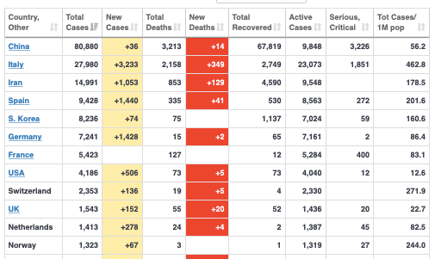
MOAR Coronavirus!
As of March 21: Things are not moving in the right direction:
What is the R0?
How can the R0 be changed?
How will the R0 change?
What is the asymptote share of the population?
What is the mortality rate?

Slide 48
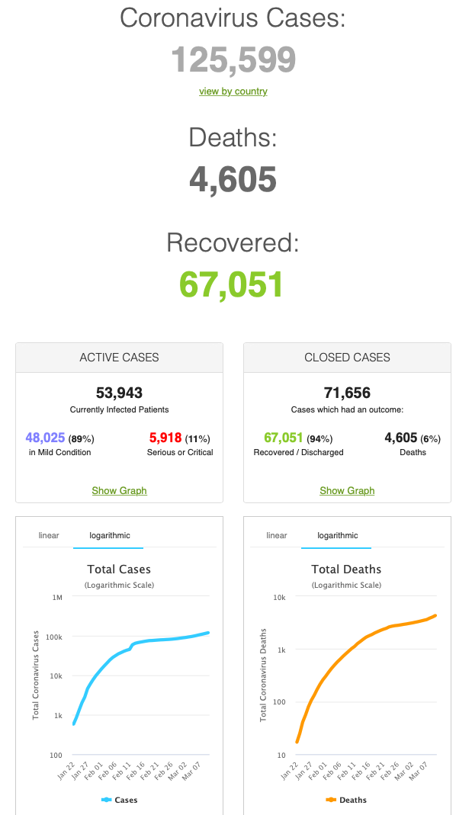
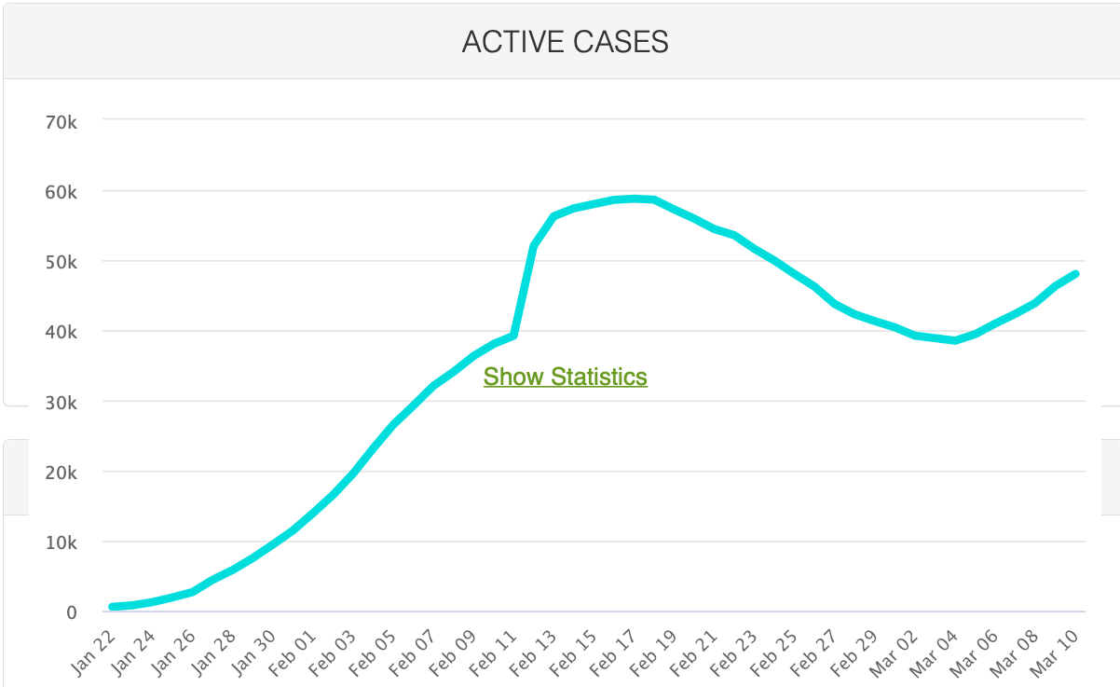
MOAR Coronavirus!
As of March 10: Things are not moving in the right direction:
What is the R0?
How can the R0 be changed?
How will the R0 change?
What is the asymptote share of the population?
What is the mortality rate?

Slide 49
Notes

Slide 50
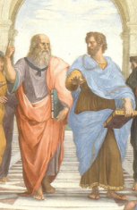
Notes, etc.…

Slide 51
Skeptical Takes on the “Institutions” Literature
Dietz Vollrath**: The Skeptics Guide to Institutions—Part 3:
<https://growthecon.wordpress.com/2014/11/23/the-skeptics-guide-to-institutions-part-3/>:
The third generation of institutions work... avoid[s] vague measurement of “institutions” by drilling down to one very specific institution… natural experiments that give them good reason to believe they are looking at exogenous variation in the institution....
These are ones I talk specifically about in class: Dell (2010). Household consumption and child health are lower in areas in Peru and Bolivia subject to the Spanish—forced labor in mines—than in areas just outside the mita. Nunn (2008). The number of slaves taken from an African country is negatively related to income per capita today. Banerjee and Iyer (2005). Agricultural output and investments in education and health are currently lower in areas of India where the British invested property rights in landlords as opposed to cultivators. Iyer (2010). Areas of India subject to direct British colonial rule have lower investments in schooling and health today than areas ruled indirectly through Indian governors. Michalopoulos and Papaioannou (2013). Pre-colonial ethnic political centralization in Africa is related to current levels of development within Africa.
So, problem solved, right? We’ve got solid empirical evidence that institutions matter. Not necessarily. What these papers demonstrate is that economic development is persistent. If you like, they are evidence that there are poverty traps. If something happens to knock you below some threshold level of development – slaving activity, the mita, arbitrary borders, bad landlords – then you can’t get yourself out of that trap. You are too poor to invest in public goods like human capital or infrastructure because you are spending all your money just trying to survive. So you stagnate.
Pushing you into the trap was the result of an “institution”, if we call these historical experiences institutions, but it isn’t institutions that keep you poor, it’s the poverty itself that prevents development…

Slide 52
Skeptical Takes on the “Institutions” Literature II
Dietz Vollrath**: The Skeptics Guide to Institutions—Part 2:
<https://growthecon.wordpress.com/2014/11/20/the-skeptics-guide-to-institutions-part-2/>:
The big event in the 2nd generation of literature was the arrival of Acemoglu, Johnson, and Robinsons (2001) using “settler mortality” as an instrument of institutional quality. They propose that the quality of institutions in a colony was a function of how deadly that colony was for European settlers.... The heart of the argument here is that institutions in colonies were exogenously determined by Europeans, and thus we have a clean empirical “natural experiment” that will yield a good estimate of the effect of institutions on economic development.... But there are... four problems....
1. They are still using an arbitrary measure of institutions as a continuous variable....
2. It is nearly impossible to believe that their instrument (settler mortality) has no separate correlation with the dependent variable (income per capita). Settler mortality... is essentially picking up the intensity of the tropical disease environment.... Europeans dying at alarming rates is simply a proxy for bad geographic conditions. And no, the fact that AJR control for latitude, temperature, and humidity is not the same thing as controlling for agricultural conditions....
3. The estimated effect of institutions doesn’t make sense. Their IV results show a coefficient for institutions that is twice as large as the OLS coefficient.... The whole reason we want IV estimates is because we think... higher income leads to better institutions. This implies that the basic correlation of institutions and income per capita is biased *upwards*....[Their] IV... implies that income per capita has a *negative* effect on institutions.... The simplest explanation for why their IV results are larger than the OLS is that there is a correlation of their instrument with the error term.... Settler mortality is independently and negatively related to income per capita... [so] the IV results are going to be larger than the OLS....
4. The data are probably wrong.... The settler mortality evidence that institutions matter just does not stack up. It certainly does not have the kind of robust, replicable features we would like in order to establish the importance of something like institutions for development.
If you want to argue that institutions matter, then by all means do so, but the AJR evidence is not something you should cite to support your case...

Slide 53
Skeptical Takes on the “Institutions” Literature III
Dietz Vollrath**: The Skeptics Guide to Institutions—Part 1:
<https://growthecon.wordpress.com/2014/11/18/the-skeptics-guide-to-institutions-part-1/>:
I take the institutions literature seriously. But there are some issues with it, and so I’m going to teach this literature from a particularly skeptical viewpoint... [that] makes it more fun to write....
The 1st-generation... (Mauro, 1995; Knack and Keefer, 1995; Hall and Jones, 1999; Easterly and Levine, 2003; Rodrik et al, 2004; Acemoglu and Johnson, 2005) regressed either growth rates or the level of income per capita on an index of institutional quality along with other controls. In general, this literature found that institutions “matter”....
The first big issue with this literature is that all the indices of institutions used are inherently arbitrary, and yet are used as if they have a strict numerical interpretation.... This is easiest to talk about by using an example. Let’s take the 7 point index for “constraint on the executive” used by Acemoglu and Johnson in their 2005 paper. 1 is “not so many constraints” and 7 is “lots and lots of constraints”.... Does Australia (7) have seven times as many constraints at Cuba (1)? Does the one-point gap between Luxembourg (7) and South Korea (6) have a similar meaning to the one-point gap between Liberia (2) and Cuba (1)?... What happens if you use the constraint on executive scores simply as categorical (i.e. dummy) variables rather than as a continuous measure? You’ll find that all of the action comes from the category for the 7’s (Western developed countries) relative to the 1’s (Cuba, North Korea, Sudan, and others).... The dummy variable for category 7 countries captures the average income per capita difference between those countries and the category 1 countries.
There might be—and certainly are—a number of things that distinguish North Korea from the U.S. beyond constraints on the executive, and the dummy is picking all those up as well....
Empirically, the best I can conclude is that Western-style social democracies are different from poor countries. Well, duh. One aspect of that may be constraints on executives, but we cannot know that for sure.
Other indices of institutions are just as bad...

Slide 54
Not “Institutions”: Disempower a Predatory Elite
Rather than say “bad institutions hobble growth”, say: an entrenched and predatory elite hobbles growth…
Dietz Vollrath: The Skeptics Guide to Institutions—Part 4:
<https://growthecon.wordpress.com/2014/11/26/the-skeptics-guide-to-institutions-part-4/>:
If we acknowledge that “institutions matter”, that does not imply that we can or should propose institutional reforms to generate economic development. It’s a mistake to think of ceteris paribus changes to institutions. They are not a thing that we can easily or independently alter. If they were, then they wouldn’t be institutions in the way that Douglass North uses the term.
If you want to generate economic development, the implication of the institutions literature is that you have to reform the underlying distribution of economic power first. Once you do that institutions will endogenously evolve towards the “good” equilibrium, whatever that may be...

Slide 55
Dietz Vollrath on “Deep Roots” of Development
Dietz Vollrath: How Deep Are the Roots of Current Economic Development?:
<https://growthecon.com/blog/topic-deep/>:
Dietz Vollrath: The Deep Roots of Development—Part 1 <https://growthecon.com/blog/Deep-Roots-1/>:
Differences in development are about differences in populations... [whic] differ substantially in not just the proximate sources of development (e.g. capital stocks and productivity levels) but in... culture and institutions... trust, patience, importance of family, and the like... these characteristics drive the proximate sources of development, and some evidence is available to back this up.
Differences in the cultural and institutional characteristics of population arose early. By early, I mean well before industrialization, conceivably back to the origins of settled agriculture in 10,000 BCE....
Whether... environmental conditions caused (some of) the differences in culture and institutions is not as clear, but evidence is accumulating that they did.
Things like culture and institutions are incredibly persistent....
While characteristics are persistent, specific historical events (e.g. the slave trade) appear capable of changing them demonstrably....
“Why are European-descended populations so rich relative to the rest of the world?”.... The environment they originated in favored the spread of cultural and institutional characteristics (e.g. trust in strangers, patience) that were conducive to economic growth.
Given that advantage, they were able to avoid (and instead impose) significant negative historical shocks on the rest of the world...

Slide 56
Levers for Development
Dietz Vollrath: The Deep Roots of Development—Part 1:
<https://growthecon.com/blog/Deep-Roots-1/>:
The deep-rooted nature of development may mean we have to find other policy levers to push….
We cannot go back in time and roll back colonization, or change inherent agricultural productivity, and so forth.
It will seem presumptuous to explain cross-cultural patience as a function of agricultural productivity around the time of the Neolithic Revolution….
There is an accumulation of papers establishing strong links between deep roots and current development, and that this is not just a few odd results…

Slide 57
Agricultural Conditions and Modern Outcomes
Dietz Vollrath: The Deep Roots of Development—Part 5:
<https://growthecon.com/blog/Deep-Roots-5/>:
The black box connecting environmental—and in particular, agricultural—conditions and modern outcomes... the effect of particular types of agriculture on cultural norms or institutional structures….
[Offsetting] the positive advantages that high agricultural productivity may have brought through time....
Anastasia Litina... within continents... places with higher inherent agricultural productivity are actually poorer... agricultural productivity may have gotten you to the industrial revolution faster, but once there it slowed you down.... Places with high productivity do not have to generate that same cooperation or trust....
Talhelm et al looked at whether there were measurable psychological differences within China associated with whether people were from the rice-growing south, or wheat-growing north. The hypothesis was that the rice-growing region would have people that... put greater weight on group outcomes....
Alesina, Giuliano, and Nunn, who looked at how agricultural areas where the plow was used have very different attitudes towards gender roles.... Fewer women work in a country when the ethnicities making up that country were traditional plow-users. The effect size is substantial, with a 15 point drop in participation comparing full plow-use to non-plow-use, on a mean of 51%....
The lesson from all these examples is that while the gross level of agricultural productivity may be central to where economic activity takes place, the kind of agriculture done has important follow-on effects that affect how this translates to living standards. The different types of agriculture—plow vs. non-plow, rice vs. wheat, etc.—created variation in cultural and institutional outcomes that influenced economic activity as well. Therefore we have places of high agricultural productivity with very different long-run outcomes....
On top of that, historical circumstances generated different responses to the agricultural conditions in place...

